Slide 1
ADC – Types and Ramp type

Slide 2
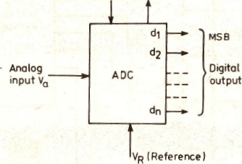
ADC
An analog-to-digital converteris an electronic circuit that converts an analog signal into digital.
It accepts an analog input voltage V_{a}
It produces an output binary word d₁ d₂... d_{n} of functional value D,
D= d₁2⁻¹+d₂2⁻²+…+d_{n}2^{-n}.
d₁ = most significant bit (MSB)
d_{n} =least significant bit (LSB)

Slide 3
ADC Types
Two additional control lines
The START input to tell the ADC when to start the conversion
The EOC (end of conversion) output to announce when the conversion is complete.
Classification of ADC
Direct type ADCs
Integrating type ADCs

Slide 4
Direct Type ADC
It compares a given analog signal with the internally generated equivalent signal.
Types
Flash (comparator) type converter
Counter type converter
Tracking or servo converter
Successive approximation type converter

Slide 5
Integrating ADC
Conversion in an indirect manner by first changing the analog input signal to a linear function of time or frequency and then to a digital code.
TYPES
Charge balancing ADC
Dual slope ADC

Slide 6
Ramp Type ADC
The operating principle is based on the measurement of the time it takes for a linear ramp voltage to rise from 0 V to the level of the input voltage or to decrease from the level of the input voltage to zero.
This time interval is measured with an electronic time-interval counter.
The count is displayed as a number of digits on electronic indicating tubes.

Slide 7
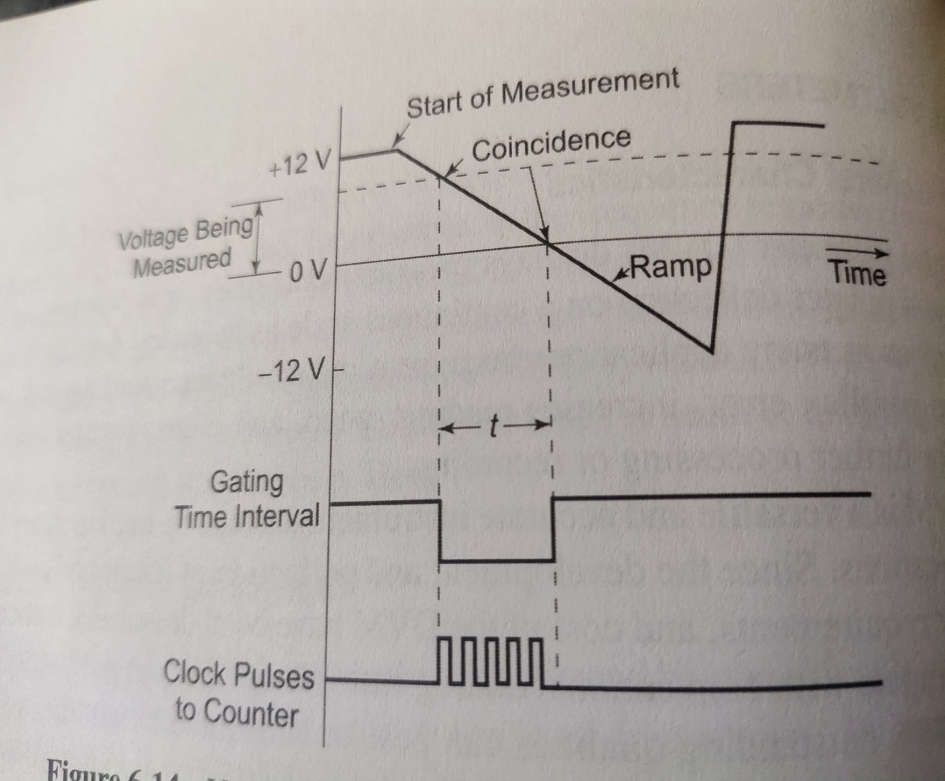
Ramp Type ADC cont…
Conversion from a voltage to a time interval is shown in waveform diagram.
At the start of the measurement cycle, a ramp voltage is initiated.
This voltage can be positive-going or negative-going.
The negative-going ramp is shown in figure.
It is continuously compared with the unknown input voltage.
At the instant that the ramp voltage equals the unknown voltage, a coincidence circuit generates a pulse which opens a gate.

Slide 8
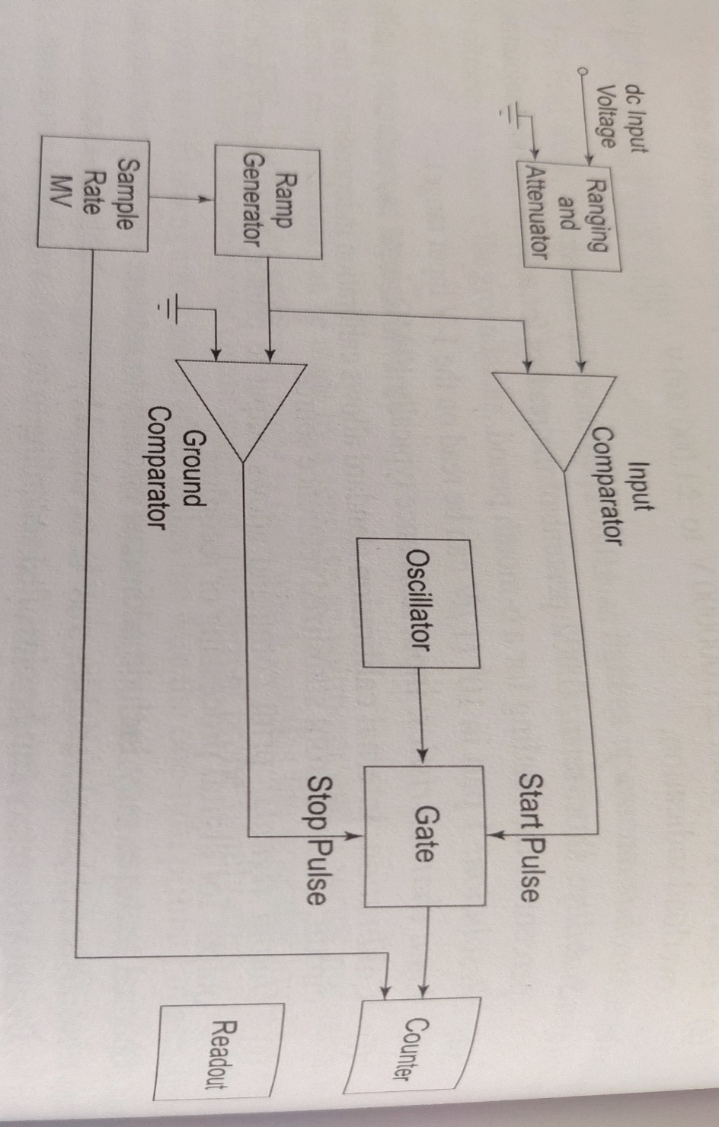
Ramp Type ADC cont…
The ramp voltage continues to decrease with time until it finally reaches 0 V.
Now a second comparator generates an output pulse which closes the gate.
An oscillator generates clock pulses.
These clock pulses are allowed to pass through the gate to a number of decade counting units (DCUs).
DCUs totalize the number of pulses passed through the gate.
The decimal number, displayed by the indicator tubes associated with the DCUs, is a measure of the magnitude of the input voltage.

Slide 9
Ramp Type ADC cont…
The sample-rate multivibrator determines the rate at which the measurement cycles are initiated.
The oscillation of this multivibrator can usually be adjusted by a front-panel control, marked rate, from a few cycles per second to as high as 1000 or more.
The sample-rate circuit provides an initiating pulse for the ramp generator to start its next ramp voltage.
At the same time, a reset pulse is generated which returns all the DCUs to their 0 state, removing momentarily from the indicator tubes.

Slide 10
Ramp Type ADC – Advantages and Disadvantages
Advantages
1. It is easy to design.
2. Low cost.
3. ADC output can be sent over long distances.
Disadvantages
1. Large errors possible due to noises.
2. Filters are required.
3. Excellent ramp linearity requirement.

